Slide 1
DevicePicker
App Design
Jarett Lund-Hopkins, Heegi Yun, James Lee, Marvin Oida, Vincent Mollicone

Slide 2
A few notes:
Our wireframe UI is drawn by hand
While DevicePicker is an iOS app in our wireframe, it could easily be ported to other platforms, such as Android, or a website and maintain most of the same layout
It follows our app flow diagram (each box on the diagram is a page on the app)
This wireframe is fairly low-fidelity, but for the final draft and the fair we plan to have our wireframe completed in Adobe XD and to be interactive

Slide 3
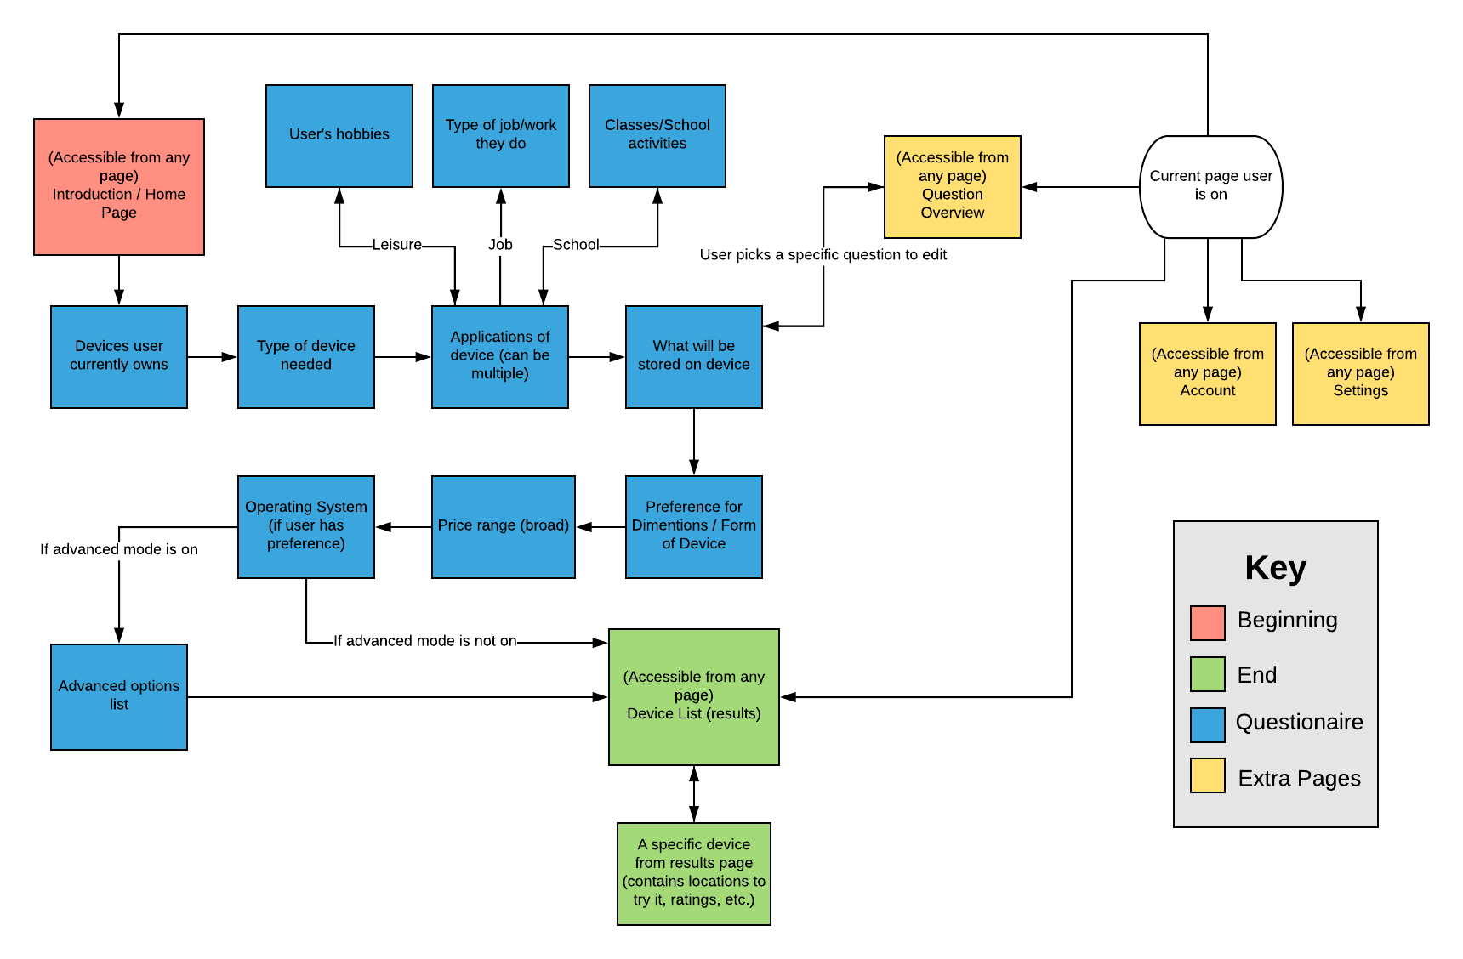
App Flow Diagram

Slide 4
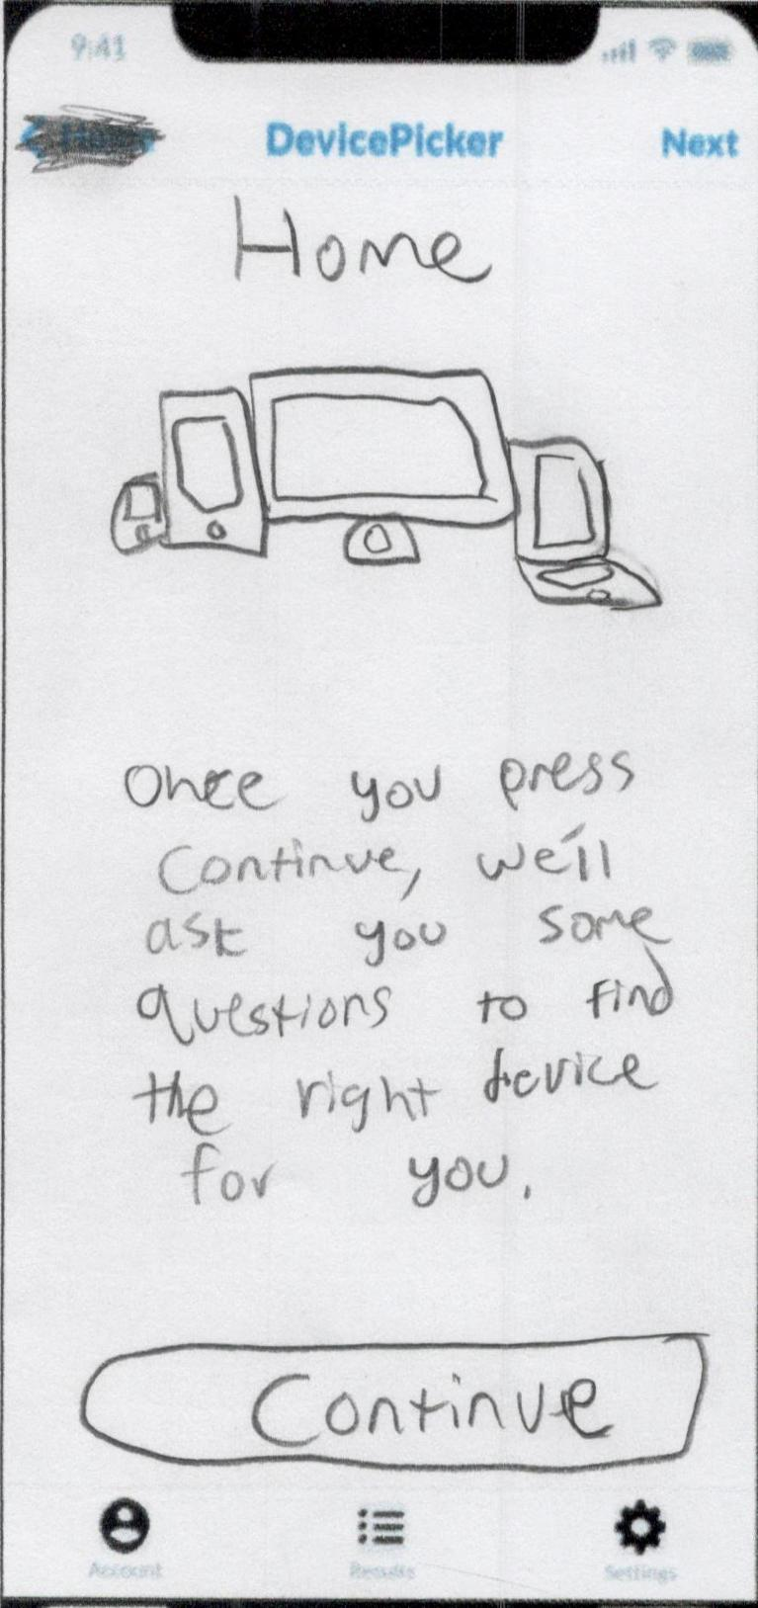
Introduction / Home Page
First page user sees
Familiarizes user with app layout
Explains what app does
Accessible from any page via “Home” on the top left

Slide 5
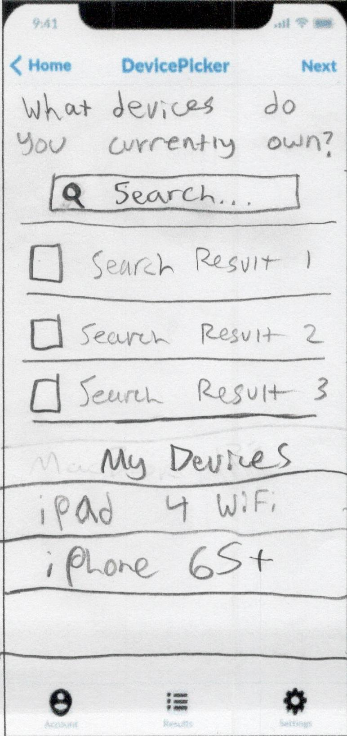
Devices user currently owns
Asks user what devices they own
User searches for their device and adds it to a list displayed on the bottom of the screen
User presses “Next” (top-right) when done making list to go to next page

Slide 6
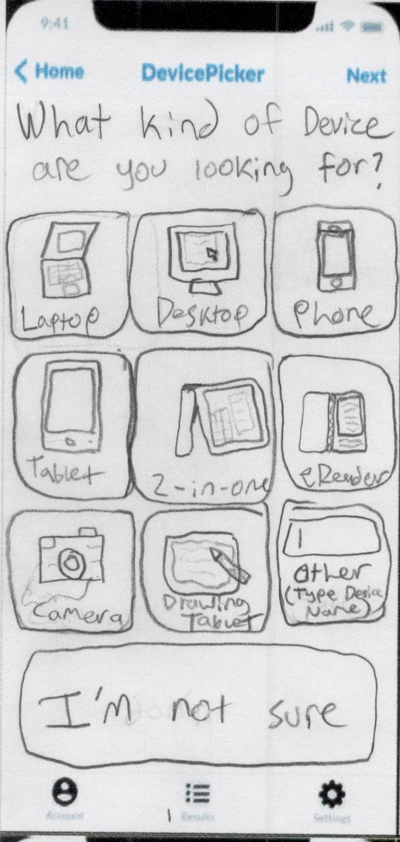
Type of device needed
User is asked what device they are looking for
Ideally scrollable for more options
Also has option to type in device name and option to skip (“I’m not sure”)
Goes to next page once user selects an option

Slide 7
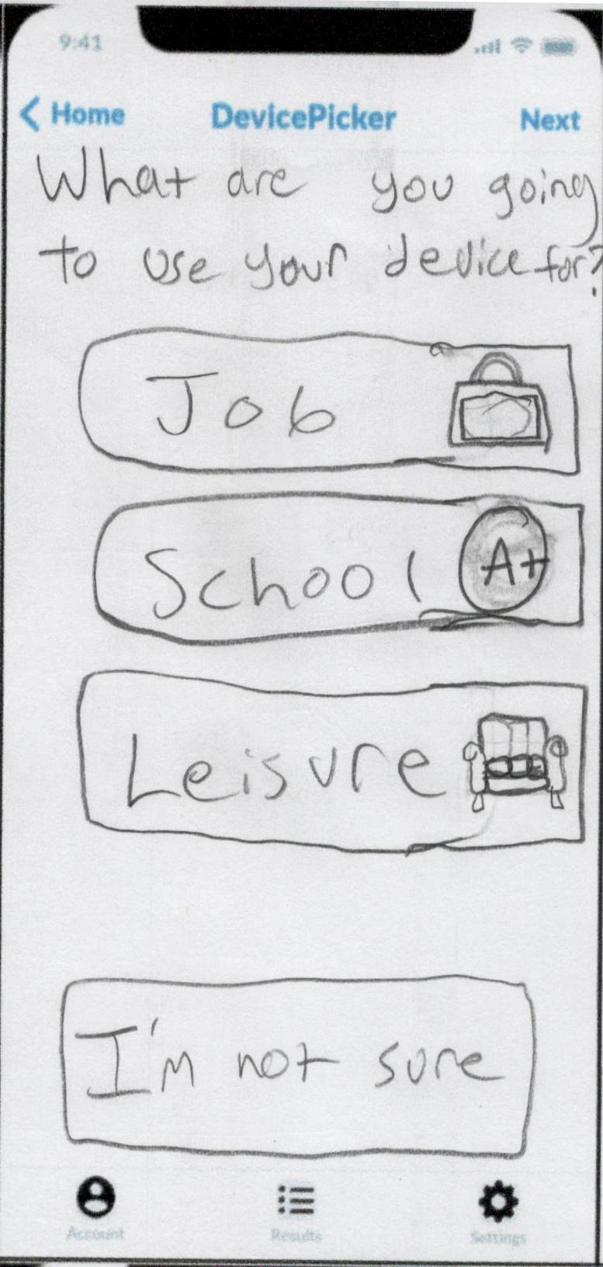
Applications of device
Asks user what they would use their device for
Has a small amount of broad options, each takes user to another page for more relative questions
User selects one or multiple options then presses “Next” to go to next page, (unless they skip (“I’m not sure”), in that case app goes to next page automatically)

Slide 8
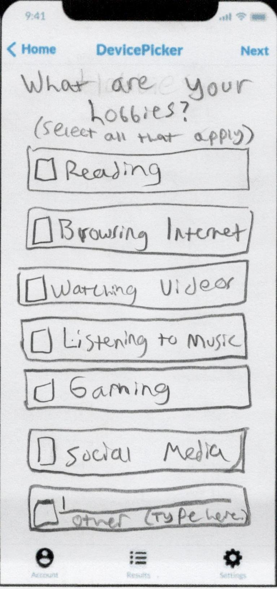
User's hobbies
Page displayed if user selected “Leisure” as device application
Asks for user’s hobbies
User can select multiple, and even type in hobbies, presses “Next” when done to go to next page

Slide 9
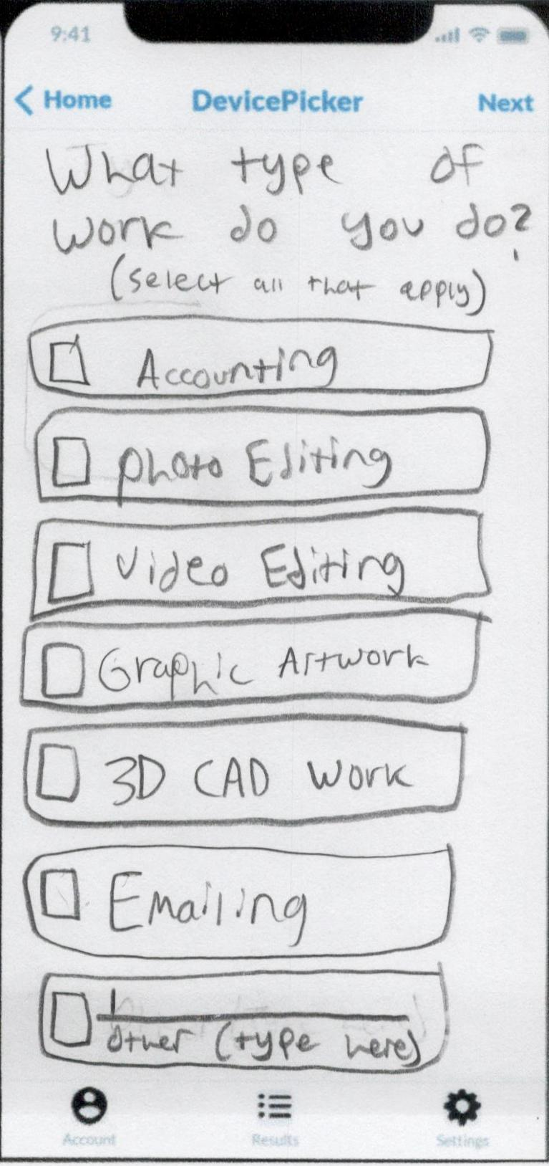
Type of job/work they do
Page displayed if user selected “Job” as device application
Asks for user’s type of job / work
User can select multiple, and even type in jobs/work, presses “Next” when done to go to next page

Slide 10
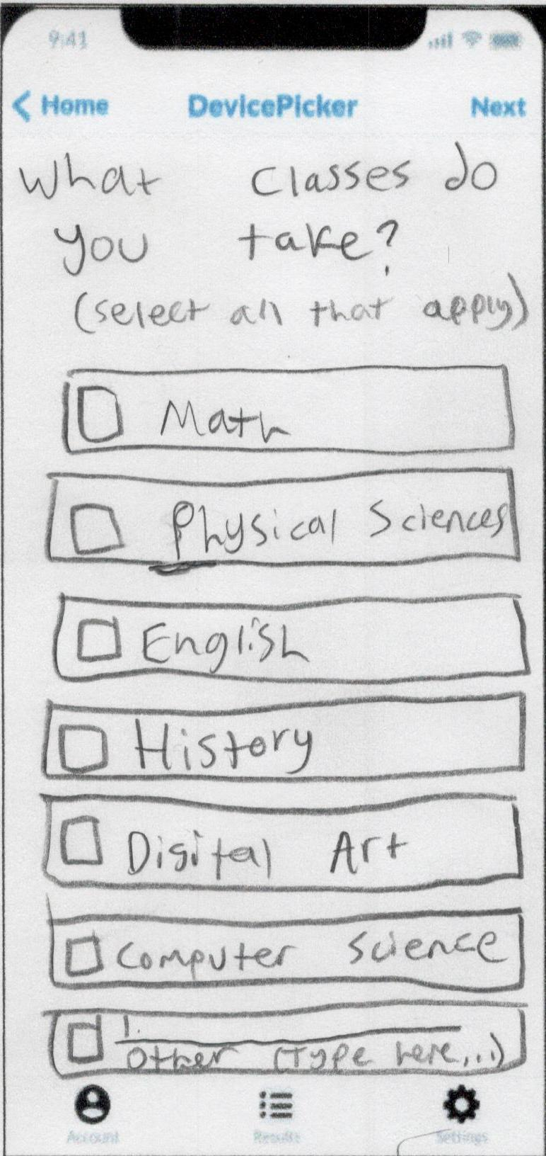
Classes/School activities
Page displayed if user selected “School” as device application
Asks for user’s type of classes
User can select multiple, and even type in classes, presses “Next” when done to go to next page

Slide 11
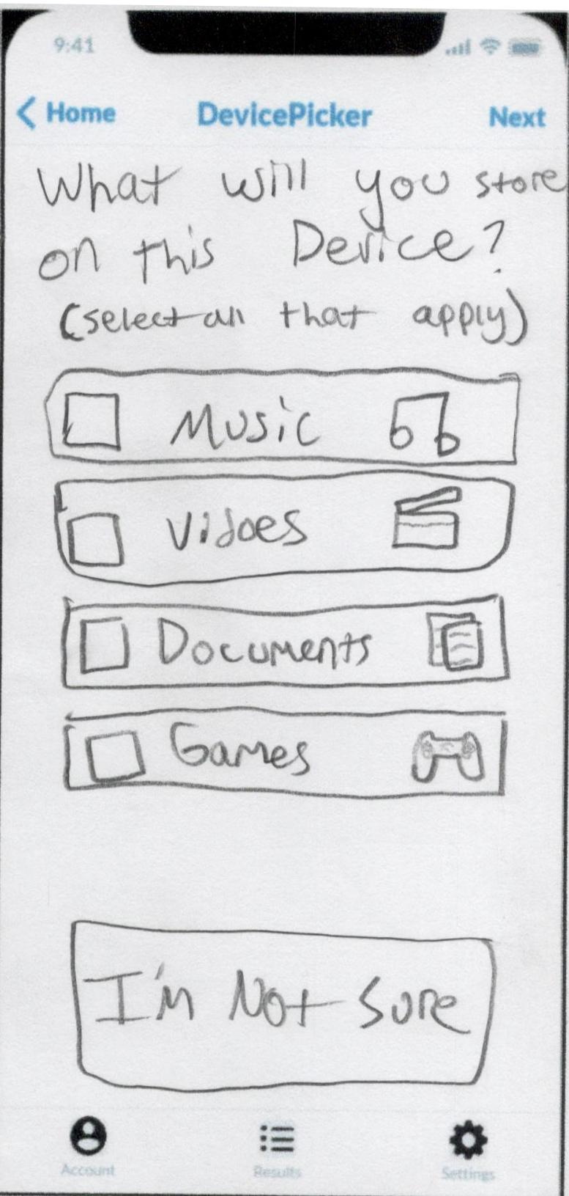
What will be stored on device
Asks what user will store on their device
Has broad options, small amount
User can skip (“I’m not sure”)
User selects one or multiple options then presses “Next” to go to next page, (unless they skip (“I’m not sure”), in that case app goes to next page automatically)

Slide 12
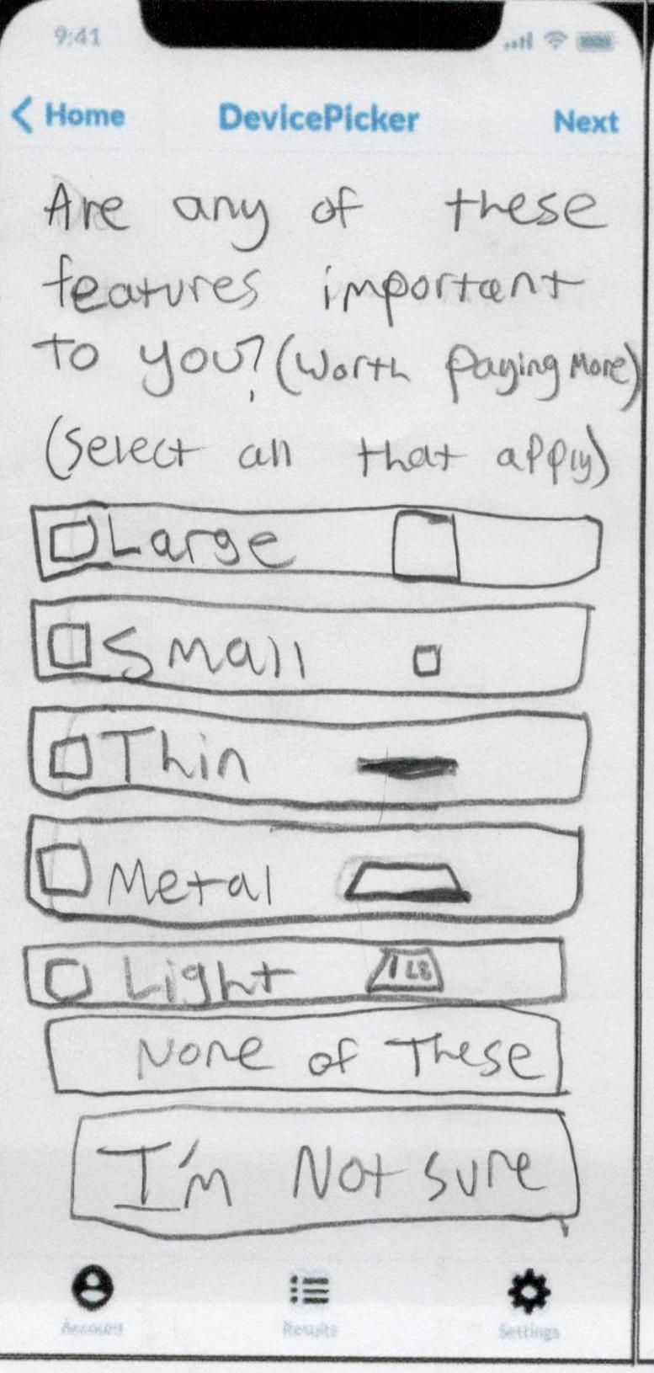
Preference for Dimentions/Form of Device
Asks if user values specific form factors for their device
Small amount of options, broad
User can select “None of these”
User can skip (“I’m not sure”)
User selects one or multiple options then presses “Next” to go to next page, (unless they skip (“I’m not sure” or “None of these”), in that case app goes to next page automatically)

Slide 13
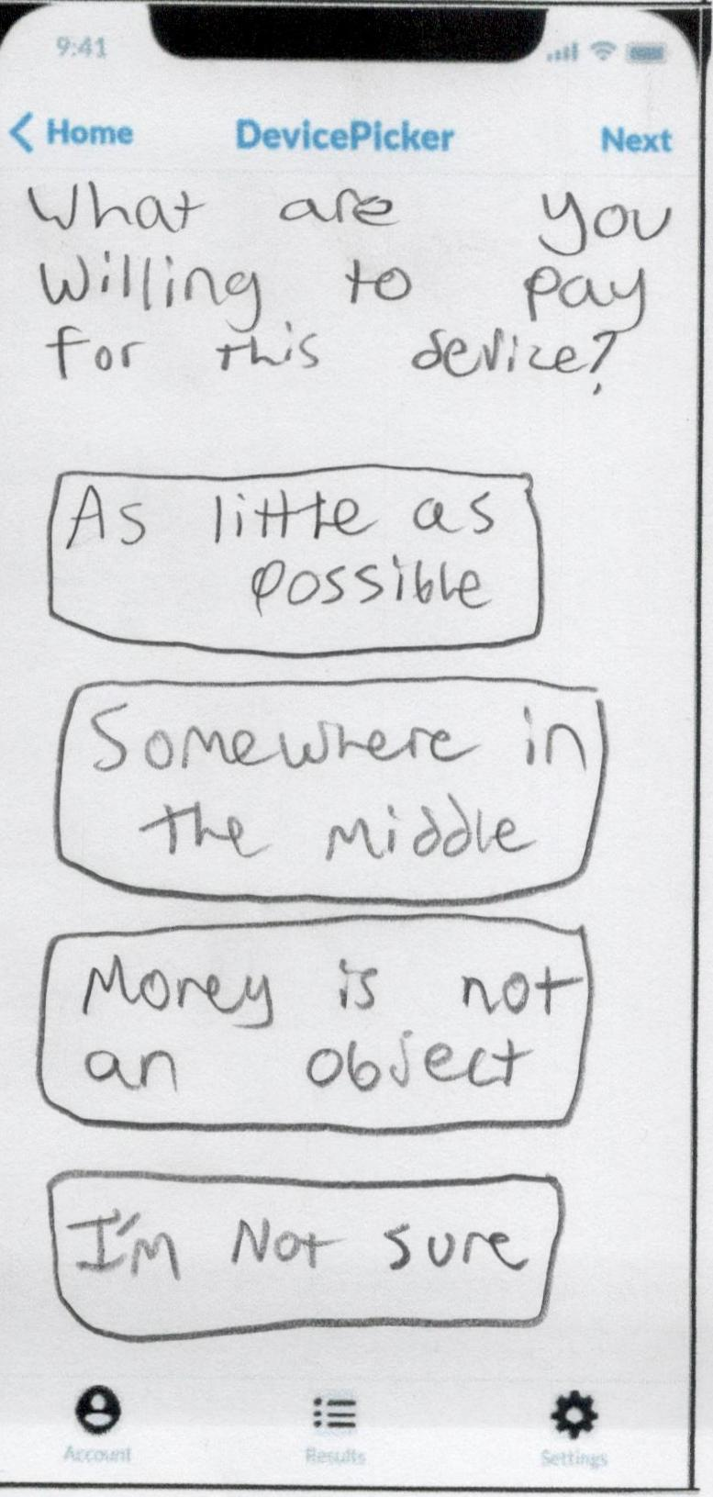
Price range (broad)
Asks what user’s price range is
Categories are numberless and slightly vague to appeal to broader mindsets
User can skip (“I’m not sure”)
Goes to next page once user selects an option

Slide 14
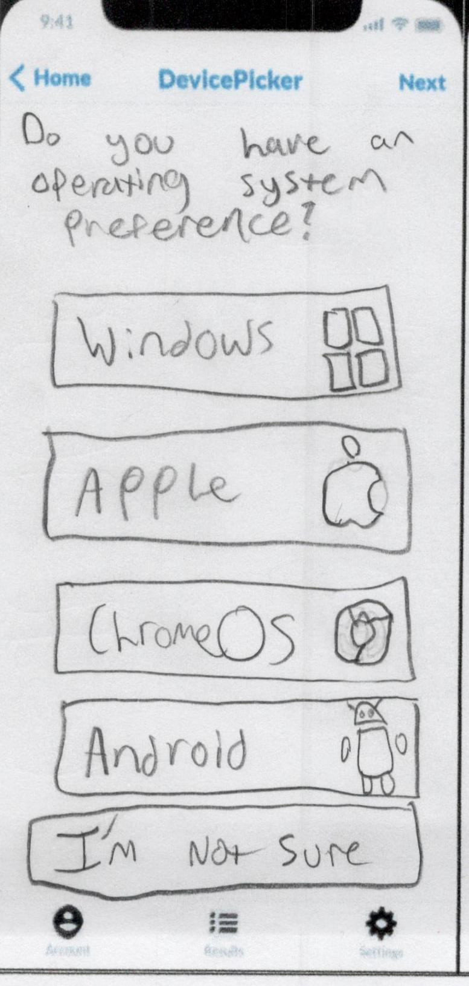
Operating System (if user has preference)
Asks what user’s preferred operating system is
User can skip (“I’m not sure”)
Goes to next page once user selects an option

Slide 15
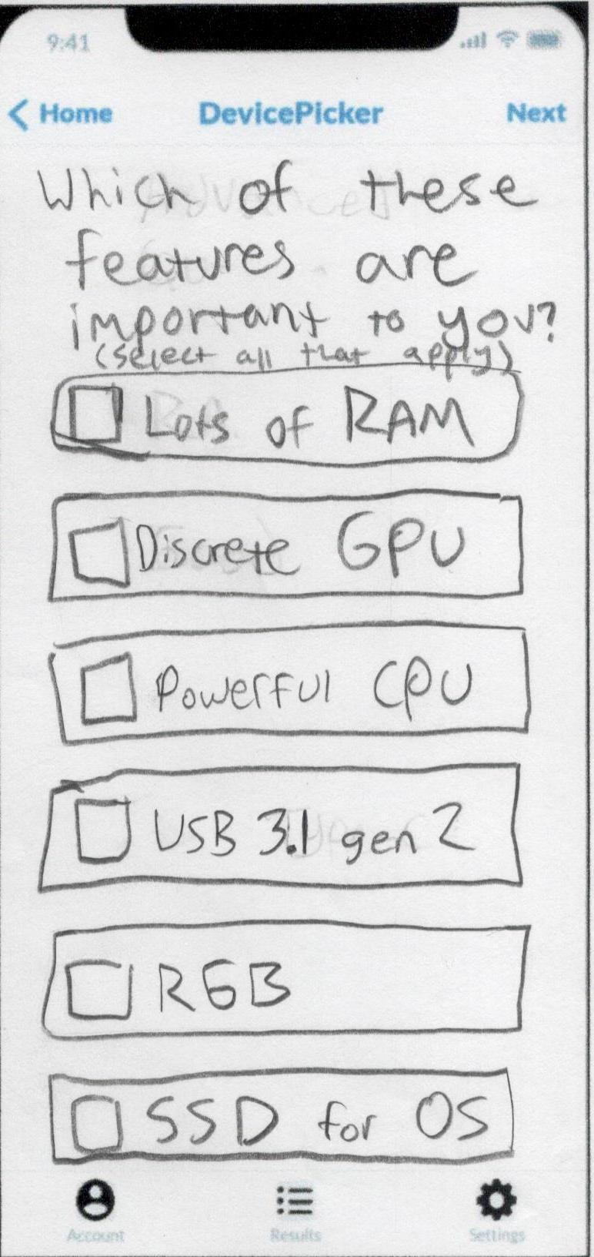
Advanced options list
Only shown if user turns “Advanced mode” on in settings menu
Asks user if certain advanced features are values, similar to form factor page
User selects zero, one, or multiple options then presses “Next” to go to next page

Slide 16
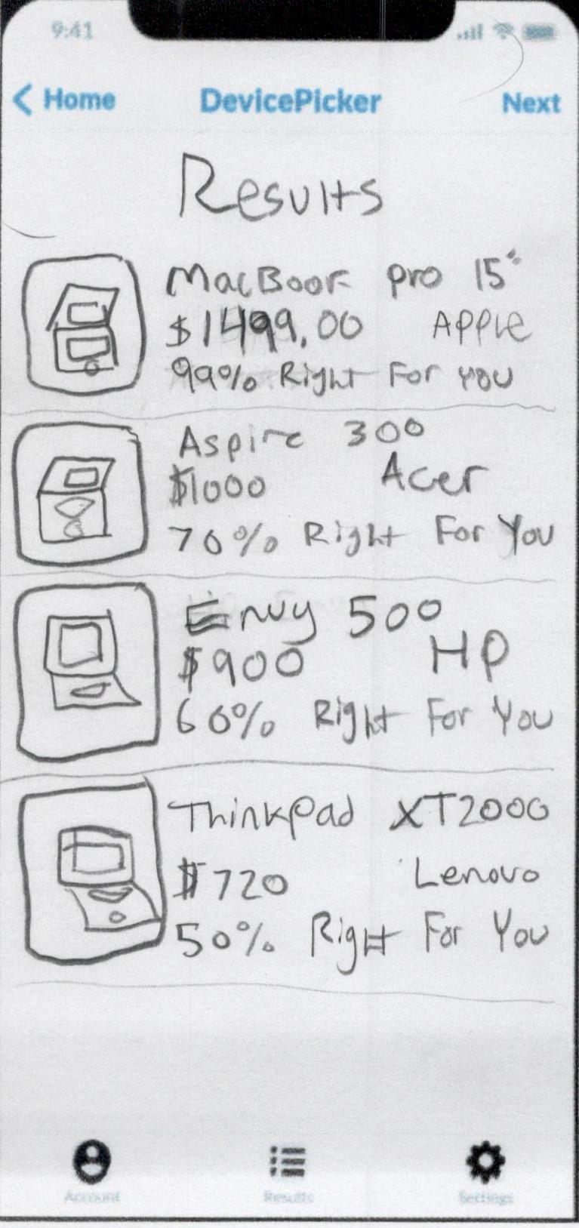
Device List (results)
Shown after user questionnaire
Also accessible from any page (“Results” in lower-middle)
Contains devices that our algorithm picked for the user
Lists multiple devices
Has name of device, price, brand, and a confidence rating that tells the user how compatible our algorithm thinks the device is for the user
User goes to next page by selecting an option

Slide 17
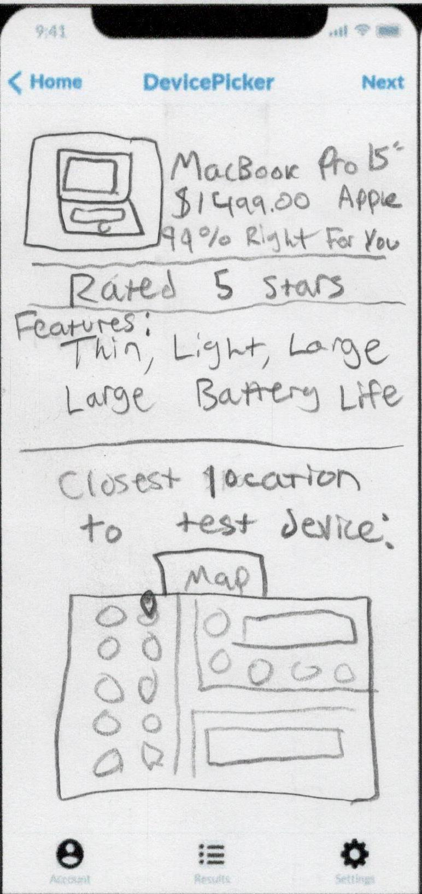
A specific device from results
Shows a single result once one is selected
Shows a more detailed view of the device selected
Finds device rating, lists attractive features that the user wanted
Shows closest location where device is on display (to buy or try device)

Slide 18
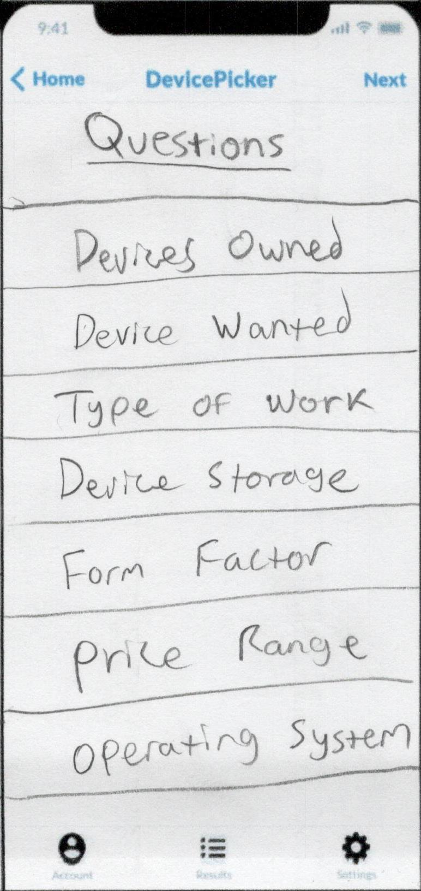
Question Overview
Accessible by pressing “Home” (top-left) once questionnaire has begun / finished
Shows overview of each question
Questions are selectable so user can change their answers

Slide 19
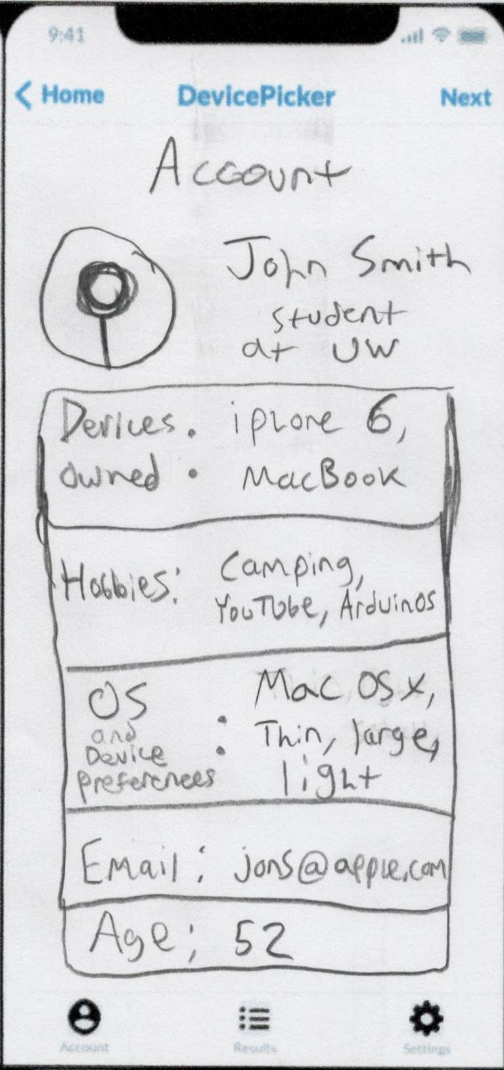
Account Menu
Accessible from any page (“Account” in lower-left)
Shows user information based on questionnaire
Also has fields such as name, email, age, and picture if user wants to give us that information

Slide 20
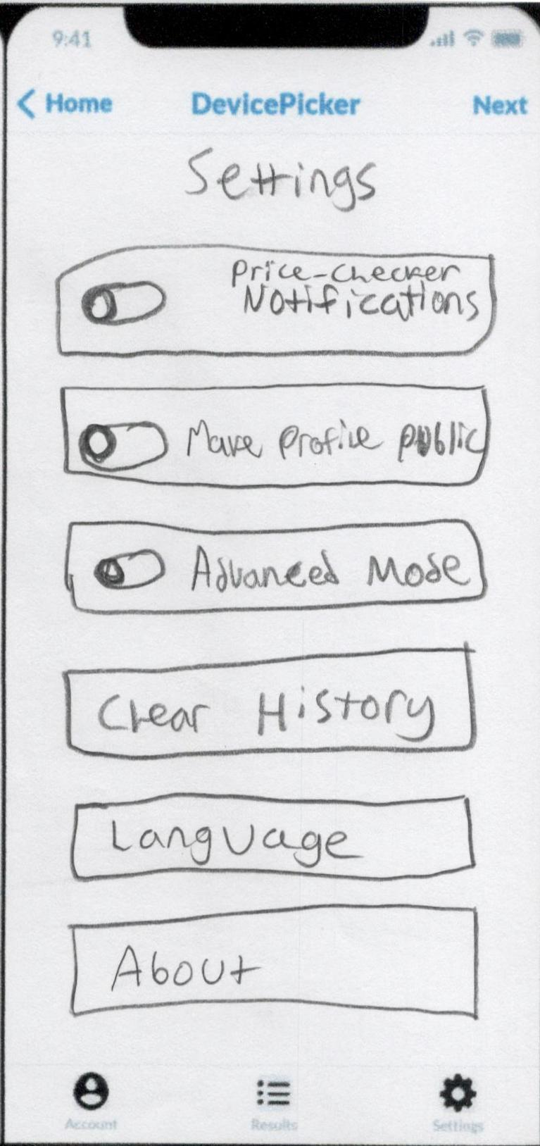
Settings Menu
Accessible from any page (“Settings” in lower-right)
Allows user to turn on notifications if their recommended devices are on sale online or near them
Has option to make profile public to share results with others
Allows user to turn on advanced mode for more tech-specific questions
Has options to clear history, switch language, and read about the developer

